Slide 1
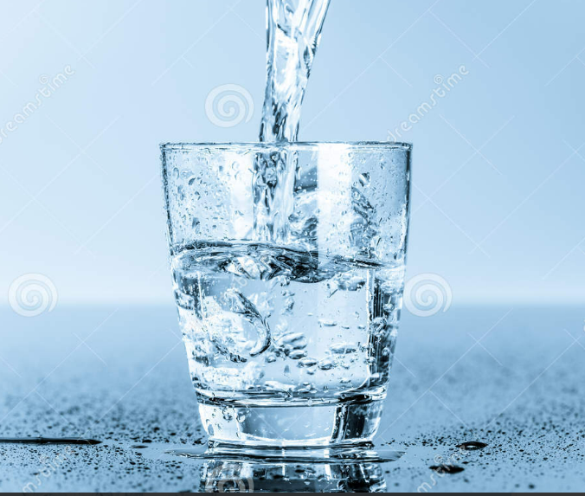
Group no.8 Drinking water potability Prediction Group members:- Manpreet kaur(0794006) Harmanpreet kaur sumal(0795660) Navneet kaur(0792027) Navdeep kaur(0795879)

Slide 2
Why we are going to work on this topic? As, all we know water is crucial for our health because people can live without food for 3 days but without water life is impossible .We use water for many purposes such as cooking, bathing, farming, washing clothes for every purpose but all water is not safe for consumption. We selected this topic because people are facing lots of problems because water is not safe to drink in many countries. But here we are going to talk about particular country that is India, as all we know water is going to pollute day by day and don’t safe to drink and people are facing many health issues because of water . The World Health Organization estimates that 97 million Indians, second only to China, do not have access to safe drinking water. As a result, the World Bank estimates that unclean water is responsible for 21% of infectious diseases in India.

Slide 3
Why water is not safe to drink in India? water contamination or water pollution in India is primarily caused by :- Industrial waste Improper agricultural practices Reduction in water quantity in plain rivers Social and religious practices such as dumping dead bodies in water, bathing, and throwing waste in water Oil leaks from ships Acid rain Global warming Eutrophication Inadequate industrial wastewater treatment.

Slide 4
Problem statement:- The problem is so bad that there may not be a single body of water in India that isn't polluted in some way. The main issues because of contaminated water is health problems that is faced by people. By drinking contaminated water, harmful bacteria enter the human digestive system, disrupting the gut's equilibrium and causing diarrhea and other illnesses . Despite advances to drinking water, many other water sources are contaminated with bio and chemical contaminants, and water-related ailments account for over 21% of all diseases. : Every year, 38 million Indians get waterborne diseases such as typhoid, cholera, and hepatitis as a result of poor infrastructure and a lack of sewage treatment. The frequency of these ailments has remained constant throughout the last decade. Waterborne infections kill more children under the age of five than AIDS, TB, and measles combined. In India, water pollution not only jeopardizes people's health and food security, but it also contributes to the country's GDP decline and economic stagnation.

Slide 5

Why is this problem important? Water is the most significant resource of life, crucial for supporting the life of most existing creatures and human beings. Living organisms need water with enough quality to continue their lives. The public requires access to safe, easily accessible water for drinking, household usage, food production, and recreational activities. A country’s economic development may be considerably boosted by better water supply and resource management. Water that is sufficient for personal and household use, constantly available, safe, accessible, and reasonably priced is a right that belongs to everyone. Thus, it is the need of the hour to have an automated system that can automatically classify the quality of water with less effort. Therefore, it is very important to suggest new approaches to analyze and, if possible, to predict the water quality .

Slide 6
Project objective The main objective of the project is improving the quality of water. Further to this, project also aims a reliable, affordable, consumer oriented and sustainable potable water supply and sanitation services. This study aims to solve these problems Firstly, a KNN imputer is used to deal with the missing values problem. Using this technique, the water quality prediction accuracy is distinctly improved compared to deleting the missing values. Secondly, a multilayer perceptron (MLP) is used for water quality prediction. Experiments are performed using different architectures for MLP.In addition, a range of machine learning models is used for comparison for the prediction of water quality with and without the KNN imputer.

Slide 7
Previous research done on drinking water in India Susie Ellis Providing access to safe water, sanitation, and hygiene (WASH) can prevent most communicable diseases. Water Aid Global and Vivid Economics in their latest report have highlighted that achieving universal access to WASH could save more than US$ 2.6 trillion in health costs between 2021 and 2040 . Yet, providing access to safe drinking water to all has remained a global challenge, more so for the developing countries. it will help bridge the gaps between stakeholders and lead to the last mile connectivity of clean and safe drinking water. This paper although focused on India has learnings that can be applied to any territory in the world where there are marginalized communities. The ambitious Jal Jeevan Mission launched by the Government of India is yielding good results . Recently the famous city of Puri in Odisha state became the first city in the country to have city-wide safe tap drinking water4 . The mission has achieved a milestone of providing tap water to every household in at least 100,000 villages across India within 23 months since its launch in August 20195 . This demonstrates that concerted efforts of partnership between the public and private sectors and the communities can achieve the most challenging tasks. However, there is so much more that remains to be done before all can have sustainable access to safe drinking water.

Slide 8
Impact on stakeholders The views of Brian Manwaring, on the development and impact of strategies that are adopted to involve stakeholders in increasing drinking water safety are presented. He suggests that an integrated water management approach that requires close cooperation and partnership between all stakeholders, including governments, independent regulatory authorities, water suppliers, local public officials, health, and environmental agencies needs to be adopted, to increase drinking water safety. The second UN World Water Development Report, 2006, has highlighted the benefits of an integrated water management approach to water resources, where stakeholders provide significant assistance throughout the planning and management process. The adoption of an integrated water management approach that involves stakeholders in the decision-making process also helps water suppliers, to collectively prevent and reduce the contamination of drinking water from source to tap.

Slide 9
Solving the problem Beyond collecting and representing data in easy formats, there is a possibility to use machine learning models on such high-resolution data to predict water quality. There are no real-time sensors available for certain crucial parameters estimating the organic content in the water, such as biochemical oxygen demand (BOD), and it can take up to five days to get results for these in a laboratory. These parameters can potentially be predicted in real-time from others whose values are available instantaneously. Once fully developed and validated, such machine learning models could predict values for intermediary values in time and space. Furthermore, adding other layers of data, such as the rainfall pattern, local temperatures, industries situated nearby and agricultural land details, could enrich the statistical analysis of the dataset.

Slide 10
knowledge/skills/tech are needed for this solution? Knowledge/skills:- Load, Explore & Clean Data Machine learning model:- Machine learning plays a significant role in enhancing the accuracy and efficacy of water quality classification. To classify water quality, there exists a variety of machine learning algorithms. The Scikit-learn library of Python has a variety of machine learning classifiers. Such as:- KNN Decision Tree Random forest Logistic regression Tableau for visualization. Tech:- Jupyter notebook using Python for creating the ML models, correlation, and comparing the accuracy.

Slide 11
Evaluating the solution There are some quick tests we may do to determine the calibre of a certain body of water, even if wemight not have access to the resources of a scientist: 1. pH value: PH is an important parameter in evaluating the acid–base balance of water. It is also the indicator of acidic or alkaline condition of water status. WHO has recommended a maximum permissible limit of pH from 6.5 to 8.5. The current investigation ranges were 6.52–6.83 which are in the range of WHO standards. 2. Hardness: Hardness is mainly caused by calcium and magnesium salts. These salts are dissolved from geologic deposits through which water travels. The length of time water is in contact with hardness producing material helps determine how much hardness there is in raw water. Hardness was originally defined as the capacity of water to precipitate soap caused by Calcium and Magnesium. 3. Solids (Total dissolved solids - TDS): Water has the ability to dissolve a wide range of inorganic and some organic minerals or salts such as potassium, calcium, sodium, bicarbonates, chlorides, magnesium, sulfates etc. These minerals produced an unwanted taste and diluted color in the appearance of water. This is the important parameter for the use of water. The water with high TDS value indicates that water is highly mineralized. The Desired limit for TDS is 500 mg/l and maximum limit is 1000 mg/l which is prescribed for drinking purposes. 4. Chloramines: Chlorine and chloramine are the major disinfectants used in public water systems. Chloramines are most commonly formed when ammonia is added to chlorine to treat drinking water. Chlorine levels up to 4 milligrams per liter (mg/L or 4 parts per million (ppm)) are considered safe in drinking water. 5. Sulfate: Sulfates are naturally occurring substances that are found in minerals, soil, and rocks. They are present in ambient air, groundwater, plants, and food. The principal commercial use of sulfate is in the chemical industry. Sulfate concentration in seawater is about 2,700 milligrams per liter (mg/L). It ranges from 3 to 30 mg/L in most freshwater supplies, although much higher concentrations (1000 mg/L) are found in some geographic locations. 6. Conductivity: Pure water is not a good conductor of electric current rather it's a good insulator. Increase in ions concentration enhances the electrical conductivity of water. Generally, the amount of dissolved solids in water determines the electrical conductivity. Electrical conductivity (EC) actually measures the ionic process of a solution that enables it to transmit current. According to WHO standards, EC value should not exceed 400 μS/cm. 7. Organic_carbon: Total Organic Carbon (TOC) in source waters comes from decaying natural organic matter (NOM) as well as synthetic sources. TOC is a measure of the total amount of carbon in organic compounds in pure water. According to the US EPA < 2 mg/L as TOC in treated / drinking water, and < 4 mg/Lit in source water which is used for treatment. 8. Trihalomethanes: THMs are chemicals which may be found in water treated with chlorine. The concentration of THMs in drinking water varies according to the level of organic material in the water, the amount of chlorine required to treat the water, and the temperature of the water that is being treated. THM levels up to 80 ppm is considered safe in drinking water. 9. Turbidity: The turbidity of water depends on the quantity of solid matter present in the suspended state. It is a measure of light emitting properties of water and the test is used to indicate the quality of waste discharge with respect to colloidal matter. The mean turbidity value obtained for Wondo Genet Campus (0.98 NTU) is lower than the WHO recommended value of 5.00 NTU. 10. Potability: Indicates if water is safe for human consumption where 1 means Potable and 0 means Not potable. (0) Water is not safe to drink and (1) Water is safe to drink.

Slide 12
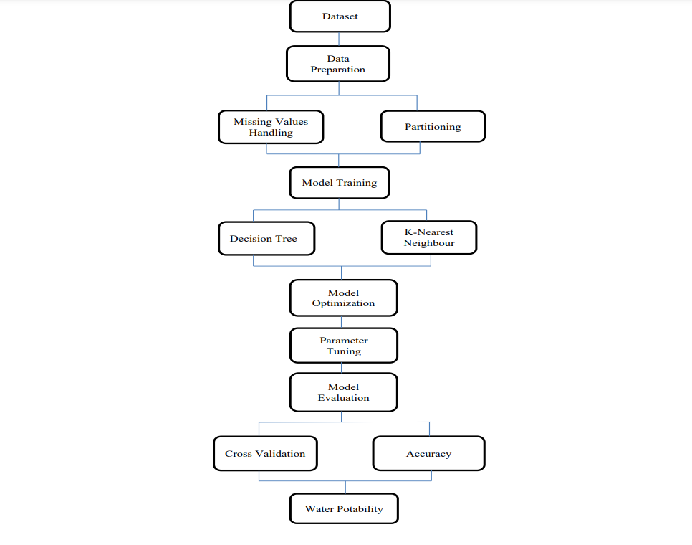
After getting the dataset we would follow these steps:-

Slide 13

Thank you

